Slide 1
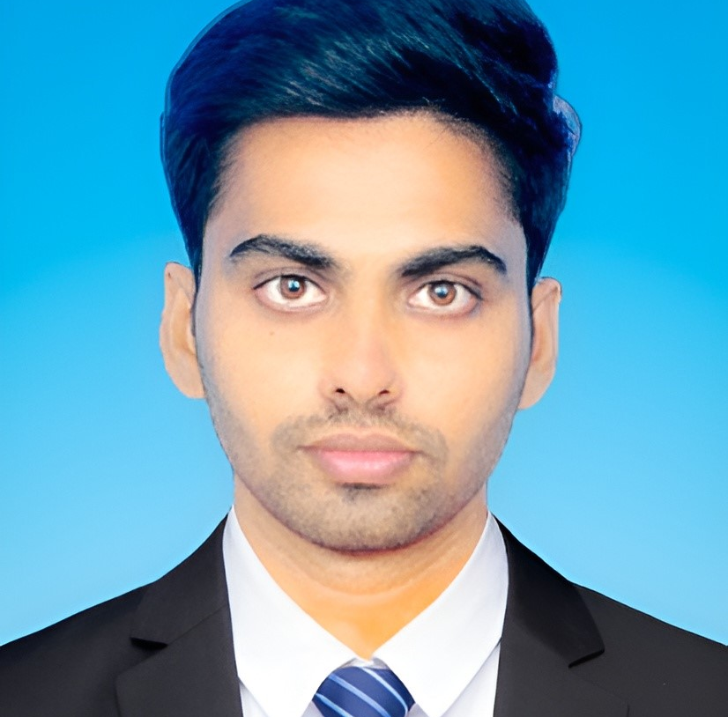




Surya Satya Sai Manikanta Rekhapalli
Bachelor of Technology
Electronics & Communication : 2018 - 2022
Analyst/Software Engineer
Skills
Bangalore
Java 8 /J2EE | Java Basics, OOPS, Generics, Collections, Arrays, Loops, Lambda Exp, Stream API Junit
Spring core | Dependency Injection
Spring REST | REST controllers, Implementation of GET, POST, PUT & DELETE, Bean Validation & Exception Handling, Testing Services, Controller & Repository layer
Spring Data JPA | Implement DAO layer using spring Data repositories, Transaction Management
Spring Boot Microservices | Spring Boot Starters, annotations, Messaging Service, Sync/Async comms, Swagger API documents
Spring Cloud | Eureka,, Netflix Hystrix, Netflix Zuul & Config Server
React | Components, Hooks, Event handling, Redux, Reducers, Testing
Database | MongoDB No SQL Basics Postgres SQL Basics ,MY SQL
UI Tech | HTML 5 & CSS 3,JavaScript Reusable templates, Optimized UI Designed
Tools | Git, Postman, Maven, IDE
Add On skills | Communications, Team management. Peer learning
rekhapalli-surya-satya-sai.manikanta@capgemini.com
+91 8374656752
A4
Full Stack Developer
Hands on experience in creating microservices with Spring Boot, Spring Security, Spring Cloud API Gateway, Eureka server, load balancing
Intermediate in creating Single page Web Application in React with Authentication with route guards, react reactive forms, routing, HTML, CSS
Hands on experience in implementing polyglot architecture with NodeJS & spring boot
Experience in creating documentation with Java docs and swagger and in unit testing using Junit, Mockito
Online Hotel Management System
Completed end to end case study of Hotel Management application along with JWT authentication, Swagger and Payment testing, responsive UI with HTML, CSS and ReactJS used for user interface.
Movie Booking System
Completed end to end case study of Moving Booking Application along with testing, responsive UI with HTML ,CSS and React is used for user interface.
Sustainability Gamification
Completed an Internal project under CTO, done with an End-to-End application and build the application successfully using Spring Boot ,Angular, MySQL & used git for code base and SonarQube for code quality checking
Certifications
AWS Cloud Practitioner Certificate
Microsoft Technology Associate HTML5 Certified
Google Cloud leader Certificate
Microsoft Azure Fundamentals Certificate.
Azure Developer Associate
Frameworks , Angular
Check out my work on GitHub & Video Profile

